Slide 1
Chapter 7: Logical Agents
Dr. Daisy Tang
In which we design agents that can form representations of the world, use a process of inference to derive new representations about the world, and use these new representations to deduce what to do.

Slide 2
Motivation of Knowledge-Based Agents
Humans know things and do reasoning, which are important for artificial agents
Knowledge-based agents benefit from knowledge expressed in general forms, combining information to suit various purposes
Knowledge and reasoning is important when dealing with partially observable environments
Understanding natural language requires inferring hidden states
Flexibility for accepting new tasks

Slide 3

Knowledge Bases
Knowledge base = set of sentences in a formal language
Declarative approach to building an agent (or other system):
Tell it what it needs to know
Then it can Ask itself what to do - answers should follow from the KB
Both “Tell” and “Ask” involve inference – deriving new sentences from old

Slide 4
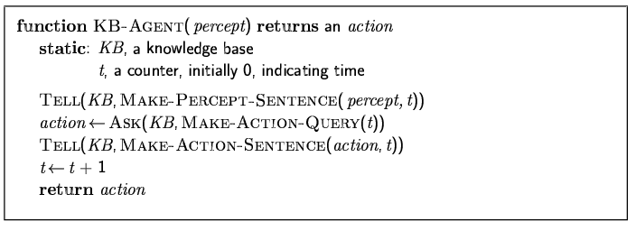
A Simple Knowledge-Based Agent
Details hidden in three functions
Similar to agent with internal state in Chapter 2
Agents can be viewed at the knowledge level
i.e., what they know, regardless of how they are implemented
Or at the implementation level
i.e., data structures in KB and algorithms that manipulate them

Slide 5
Agent’s Requirements
The agent must be able to:
Represent states, actions, etc.
Incorporate new percepts
Update internal representations of the world
Deduce hidden properties of the world
Deduce appropriate actions

Slide 6
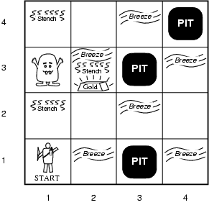
Our New Toy Problem – Wumpus World

Slide 7
Wumpus World PEAS
Performance measure
gold +1000, death -1000
-1 per step, -10 for using the arrow
Environment
4x4 grid of rooms
Agent always starts at [1,1]
Wumpus and gold randomly chosen
Each square other than start is pit with 0.2 probability

Slide 8
Wumpus World PEAS
Actuators: Left turn, Right turn, Forward, Grab, Release, Shoot, Climb
Shooting kills wumpus if you are facing it
Shooting uses up the only arrow
Grabbing picks up gold if in same square
Releasing drops the gold in same square
Climbing out of the cave from [1, 1]
Sensors (percepts): Stench, Breeze, Glitter, Bump, Scream
Squares adjacent to wumpus are smelly
Squares adjacent to pit are breezy
Glitter iff gold is in the same square
Bump when agent walks into a wall
When wumpus is killed, it screams

Slide 9
Wumpus World Properties
Fully observable?
No – only local perception
Deterministic?
Yes – outcomes exactly specified
Episodic?
No – sequential at the level of actions
Static?
Yes – Wumpus and Pits do not move
Discrete?
Yes
Single-agent?
Yes – Wumpus is essentially a natural feature

Slide 10
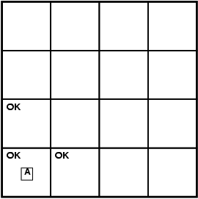
Exploring a Wumpus World
Agent’s initial knowledge base contains the rules of the environment: it knows that it’s at [1,1] and it’s safe at [1,1]
percept: [none, none, none, none, none]

Slide 11
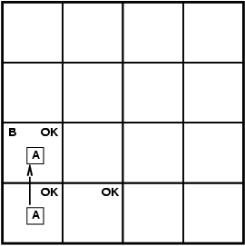
Exploring a Wumpus World
percept: [none, breeze, none, none, none]

Slide 12
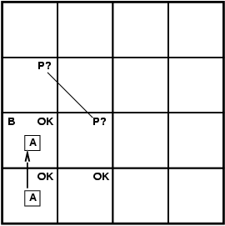
Exploring a Wumpus World
percept: [none, breeze, none, none, none]

Slide 13
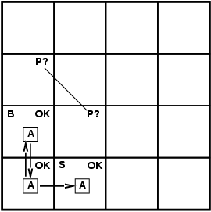
Exploring a Wumpus World
our cautious agent will go back and to [2,1]

Slide 14
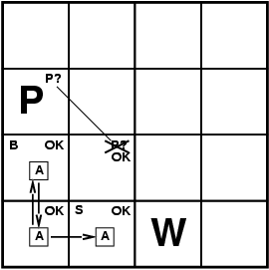
Exploring a Wumpus World
percept: [stench, none, none, none, none]

Slide 15

Exploring a Wumpus World
percept: [none, none, none, none, none]

Slide 16
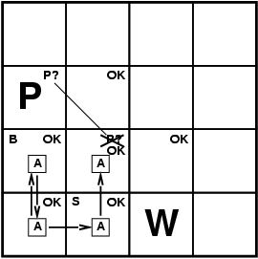
Exploring a Wumpus World

Slide 17
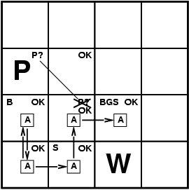
Exploring a Wumpus World
percept: [stench, breeze, glitter, none, none]

Slide 18
Logical Reasoning
In each case where the agent draws a conclusion from the available information, that conclusion is guaranteed to be correct if the available information is correct
The above is the fundamental of logical reasoning

Slide 19
Logic in General
Logics are formal languages for representing information such that conclusions can be drawn
Syntax defines the sentences in the language
Semantics define the "meaning" of sentences;
i.e., define truth of a sentence in a world
E.g., the language of arithmetic
x+2 ≥ y is a sentence; x2+y > {} is not a sentence
x+2 ≥ y is true iff the number x+2 is no less than the number y
x+2 ≥ y is true in a world where x = 7, y = 1
x+2 ≥ y is false in a world where x = 0, y = 6

Slide 20
Entailment
Now, we have a notion of truth, we are ready to study logical reasoning, which involves logical entailment between sentences
Entailment means that one thing follows from another:
KB ╞ α
Knowledge base KB entails sentence α if and only if α is true in all worlds where KB is true
E.g., the KB containing “the Giants won” and “the Reds won” entails “Either the Giants won or the Reds won”
E.g., x+y = 4 entails 4 = x+y
Entailment is a relationship between sentences (i.e., syntax) that is based on semantics

Slide 21
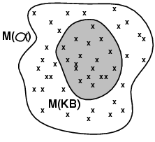
Models
We use the term “model” to represent “possible world”
We say m is a model of a sentence α if α is true in model m
M(α) is the set of all models of α
Then KB ╞ α iff M(KB) ⊆ M(α)
E.g. KB = Giants won and Reds won, α = Giants won

Slide 22
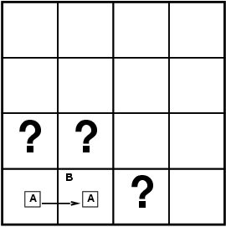
Entailment in the Wumpus World
Situation after detecting nothing in [1,1], moving right, breeze in [2,1]
Consider possible models for KB assuming only pits
3 Boolean choices ⇒ 8 possible models

Slide 23
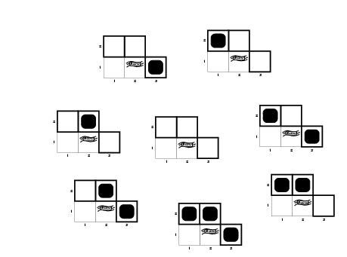
Wumpus Models

Slide 24
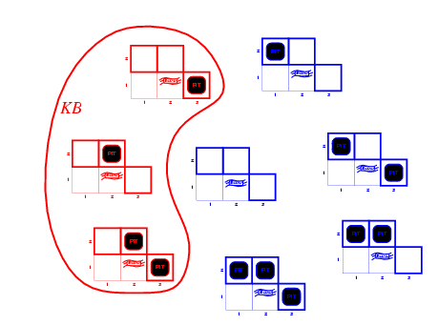
Wumpus Models
KB = wumpus-world rules + observations

Slide 25
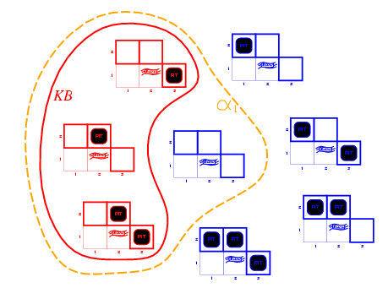
Wumpus Models
KB = wumpus-world rules + observations
α₁ = "[1,2] is safe", KB ╞ α₁, proved by model checking
enumerate all possible models to check that α is true in all models in which KB is true

Slide 26
Wumpus Models
KB = wumpus-world rules + observations

Slide 27
Wumpus Models
KB = wumpus-world rules + observations
α₂ = "[2,2] is safe“, KB ╞ α₂?

Slide 28
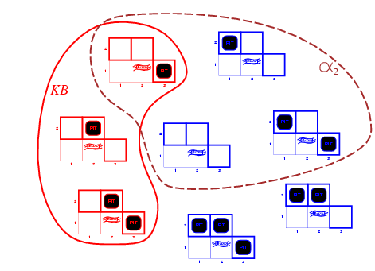
Wumpus Models
KB = wumpus-world rules + observations
α₂ = "[2,2] is safe", KB ╞ α₂

Slide 29
Soundness and Completeness
An inference algorithm that derives only entailed sentences is called sound
An inference algorithm is complete if it can derive any sentence that is entailed
If KB is true in the real world, then any sentence derived from KB by a sound inference procedure is also true in the real world

Slide 30
Grounding Problem
Grounding: how do we know that KB is true in the real world?
Agent’s sensors create the connection
Meaning and truth of percept sentences through sensing and sentence construction
General rules
From perceptual experience

Slide 31
Propositional Logic: Syntax
Propositional logic is the simplest logic – illustrates basic ideas
The proposition symbols S₁, S₂ etc are sentences
If S is a sentence, ¬S is a sentence (negation)
If S₁ and S₂ are sentences, S₁ ∧ S₂ is a sentence (conjunction)
If S₁ and S₂ are sentences, S₁ ∨ S₂ is a sentence (disjunction)
If S₁ and S₂ are sentences, S₁ ⇒ S₂ is a sentence (implication)
If S₁ and S₂ are sentences, S₁ ⇔ S₂ is a sentence (biconditional)

Slide 32
Propositional Logic: Semantics
Each model specifies true/false for each proposition symbol
E.g. P_{1,2} P_{2,2} P_{3,1}
false true false
With these symbols, 8 possible models, can be enumerated automatically.
Rules for evaluating truth with respect to a model m:
¬S is true iff S is false
S₁ ∧ S₂ is true iff S₁ is true and S₂ is true
S₁ ∨ S₂ is true iff S₁is true or S₂ is true
S₁ ⇒ S₂ is true iff S₁ is false or S₂ is true
i.e., is false iff S₁ is true and S₂ is false
S₁ ⇔ S₂ is true iff S₁⇒S₂ is true and S₂⇒S₁ is true
Simple recursive process evaluates an arbitrary sentence, e.g.,
¬P_{1,2} ∧ (P_{2,2} ∨ P_{3,1}) = true ∧ (true ∨ false) = true ∧ true = true

Slide 33
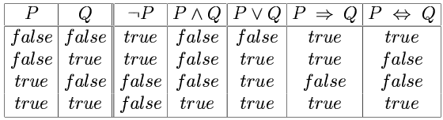
Truth Tables for Connectives

Slide 34
Wumpus World Sentences
Let P_{i,j} be true if there is a pit in [i, j]
Let B_{i,j} be true if there is a breeze in [i, j]
R1: ¬P_{1,1}
R2: ¬B_{1,1}
R3: B_{2,1}
"Pits cause breezes in adjacent squares“
R4: B_{1,1} ⇔ (P_{1,2} ∨ P_{2,1})
R5: B_{2,1} ⇔ (P_{1,1} ∨ P_{2,2} ∨ P_{3,1})
The KB consists of the above 5 sentences. It can also be considered as a single sentence – the conjunction R1 ∧ R2 ∧ R3 ∧ R4 ∧ R5

Slide 35
Inference
The aim of logical inference is to decide whether KB╞ Ɑ for some sentence Ɑ.
Is P_{2,2} entailed?
Our first algorithm for inference will be a direct implementation of the definition of entailment:
Enumerate the models, and check that Ɑ is true in every model in which KB is true

Slide 36
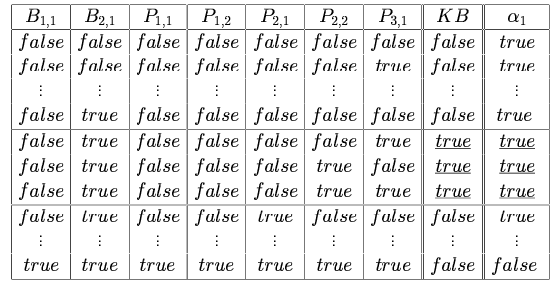
Truth Tables for Inference
P_{1,2} is false, cannot decide on p_{2,2}
α₁ = "[1,2] is safe"

Slide 37
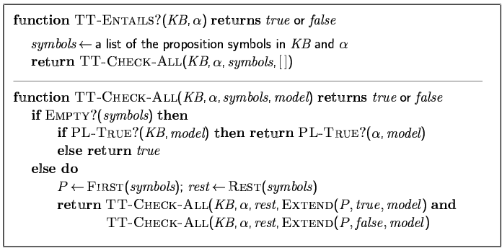
Inference by Enumeration
Depth-first enumeration of all models is sound and complete
For n symbols, time complexity is O(2^{n}), space complexity is O(n)
PL-TRUE? returns true if a sentence holds within a model.

Slide 38
Proof Methods In General
Proof methods divide into (roughly) two kinds:
Model checking
truth table enumeration (always exponential in n)
improved backtracking, e.g., Davis--Putnam-Logemann-Loveland (DPLL)
heuristic search in model space (sound but incomplete)
e.g., min-conflicts-like hill-climbing algorithms
Application of inference rules
Legitimate (sound) generation of new sentences from old
Proof = a sequence of inference rule applications
Can use inference rules as operators in a standard search algorithm
Typically require transformation of sentences into a normal form

Slide 39
Validity and Satisfiability
A sentence is valid if it is true in all models, also known as tautology
e.g., True, A ∨ ¬A, A ⇒ A, (A ∧ (A ⇒ B)) ⇒ B
Validity is connected to inference via the Deduction Theorem
KB ╞ α if and only if (KB ⇒ α) is valid
A sentence is satisfiable if it is true in some model
e.g., A ∨ B, C
A sentence is unsatisfiable if it is true in no models
e.g., A ∧ ¬A
Satisfiability is connected to inference via the following:
KB ╞ α if and only if (KB ∧ ¬α) is unsatisfiable
Thus proof by contradiction

Slide 40
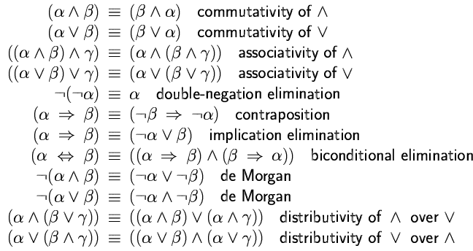
Equivalence Rules
Two sentences are logically equivalent iff they are true in the same models: α ≡ ß iff α╞ β and β╞ α

Slide 41
Inference Rules
From | Can Derive | Abbreviation for rule
R, R → S | S | Modus Ponens- mp
R → S, S´ | R´ | Modus Tollens- mt
R, S | R Λ S | Conjunction-con
R Λ S | R, S | Simplification- sim
R | R V S | Addition- add
R1: ¬P_{1,1}
R2: B_{1,1} ⬄ P_{1,2} V P_{2,1}
R3: B_{2,1} ⬄ P_{1,1} V P_{2,2} V P_{3,1}
R4: ¬B_{1,1}
R5: B_{2,1}
Can we prove ¬P_{1,2}?

Slide 42
In-Class Exercises #7.1
From | Can Derive | Abbreviation for rule
R, R → S | S | Modus Ponens- mp
R → S, S´ | R´ | Modus Tollens- mt
R, S | R Λ S | Conjunction-con
R Λ S | R, S | Simplification- sim
R | R V S | Addition- add
Prove ¬P_{2,1} and P_{3,1} given:

Slide 43
Proof Problem as Search Problem
Initial state: initial knowledge base
Actions:
set of actions consists of all the inference rules applied to all the sentences that match the left half of the inference rule
Result: add the sentence in the right half of the inference rule
Goal: the goal is a state that contains the sentence we are trying to prove
Practically, finding a proof can be more efficient because the proof can ignore irrelevant propositions, no matter how many of them there are

Slide 44
Resolution
The inference rules can be applied whenever suitable premises are found in the KB
The conclusion of the rule must follow regardless of what else is in the KB
The above rules are sound, but if the available inference rules are inadequate, then it’s not complete
Now, we introduce a single inference rule, resolution, that gives a complete inference algorithm when coupled with any complete search algorithm

Slide 45
Example
Recall our previous proof of P_{3,1} given:
Unit resolution
Resolution rule: ¬P_{1,1} resolves with P_{1,1} in R9
Resolution rule: ¬P_{2,2} resolves with P_{2,2} in R10

Slide 46
Resolution Rules
Unit resolution
li and m are complementary literals
Generalized resolution rule
l ₁ ∨… ∨ l _{k}, m
l ₁ ∨ … ∨ l _{i-1} ∨ l _{i+1} ∨ … ∨ l_{k}
l ₁ ∨… ∨ l _{k}, m₁ ∨ … ∨ m _{n} l ₁ ∨ … ∨ l _{i-1} ∨ l _{i+1} ∨ … ∨ l_{k} ∨ m₁ ∨ … ∨ m _{j-1} ∨ m _{j+1} ∨... ∨ m _{n}
where li and mj are complementary literals

Slide 47
Soundness and Completeness
Soundness of resolution inference rule:
if l _{i} is true, then m_{j} is false
hence (m₁ ∨ … ∨ m _{j-1} ∨ m _{j+1} ∨... ∨ m_{n}) must be true
if l _{i} is false, then
(l₁ ∨ … ∨ l _{i-1} ∨ l _{i+1} ∨ … ∨ l_{k}) must be true
no matter what
(l₁ ∨ … ∨ l _{i-1} ∨ l _{i+1} ∨ … ∨ l_{k}) V (m₁ ∨ … ∨ m _{j-1} ∨ m _{j+1} ∨... ∨ m_{n}) is true
Any complete search algorithm, applying only the resolution rule, can derive any conclusion entailed by any knowledge base in propositional logic

Slide 48
A resolution-based theorem prover can, for any sentences α and β in propositional logic, decide whether α╞ β

Slide 49
Resolution and CNF
Resolution rule applies only to disjunctions of literals
Every sentence of propositional logic is logically equivalent to a conjunction of disjunctions of literals
Conjunctive Normal Form (CNF):
conjunction of disjunctions of literals clauses
E.g., (A ∨ ¬B) ∧ (B ∨ ¬C ∨ ¬D)
P_{1,3} ∨ P_{2,2}, ¬P_{2,2}
P_{1,3}

Slide 50
Conversion to CNF
B_{1,1} ⇔ (P_{1,2} ∨ P_{2,1})
1. Eliminate ⇔, replacing α ⇔ β with (α ⇒ β)∧(β ⇒ α). (B_{1,1} ⇒ (P_{1,2} ∨ P_{2,1})) ∧ ((P_{1,2} ∨ P_{2,1}) ⇒ B_{1,1})
2. Eliminate ⇒, replacing α ⇒ β with ¬α∨ β. (¬B_{1,1} ∨ P_{1,2} ∨ P_{2,1}) ∧ (¬(P_{1,2} ∨ P_{2,1}) ∨ B_{1,1})
3. Move ¬ inwards using de Morgan's rules and double-negation: (¬B_{1,1} ∨ P_{1,2} ∨ P_{2,1}) ∧ ((¬P_{1,2} ∧ ¬P_{2,1}) ∨ B_{1,1})
4. Apply distributive law (∧ over ∨) and flatten: (¬B_{1,1} ∨ P_{1,2} ∨ P_{2,1}) ∧ (¬P_{1,2} ∨ B_{1,1}) ∧ (¬P_{2,1} ∨ B_{1,1})

Slide 51
Resolution Algorithm
To show that KB╞ α, we show that (KB ^ ¬α) is unsatisfiable, proof by contradiction
First, (KB ^ ¬α) is converted into CNF
Then the resolution rule is applied to the resulting clauses
Each pair that contains complementary literals is resolved to produce a new clause, which is added to the set if it’s not present
Process continues until:
no new clauses can be added, thus KB does not entail α
two clauses resolve to yield {}, thus KB entails α
{} is a disjunction of no disjuncts is equivalent to False, thus the contradiction

Slide 52
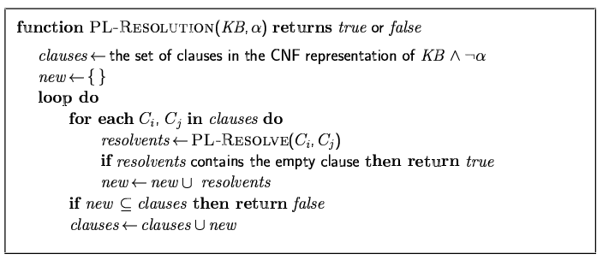
Resolution Algorithm
Proof by contradiction, i.e., show that KB∧¬α is unsatisfiable

Slide 53
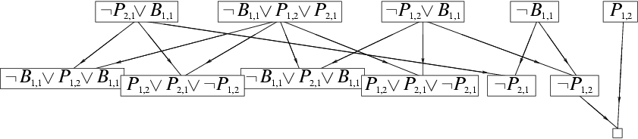
Resolution Example
KB = (B_{1,1} ⇔ (P_{1,2}∨ P_{2,1})) ∧¬ B_{1,1} α = ¬P_{1,2}

Slide 54
Horn Clauses
Why horn clauses?
In many practical situations, however, the full power of resolution is not needed
Real-world KBs often contain some restricted clauses – Horn clauses
Horn Form (restricted)
KB = conjunction of Horn clauses
Horn clause = disjunction of literals of which at most one is positive
E.g., (¬L_{1,1} V ¬Breeze V B_{1,1})

Slide 55
Properties of Horn Clauses
Every horn clause can be written as an implication whose premise is a conjunction of positive literals and whose conclusion is a single positive literal
E.g., (L_{1,1} ^ Breeze) ⇒ B_{1,1}
Modus Ponens (for Horn Form): complete for Horn KBs
α₁, … ,α_{n}, α₁ ∧ … ∧ α_{n} ⇒ β β
Definite clause: horn clauses with exactly one positive literal
The positive literal is called the head and the negative literals form the body
Definite clauses form the basis for logic programming
Can be used with forward chaining or backward chaining
These algorithms are very natural and run in linear time

Slide 56
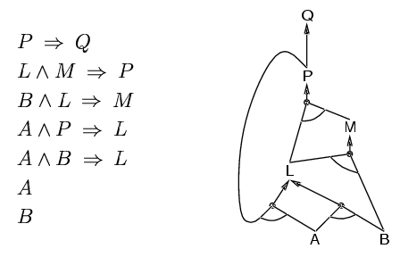
Forward Chaining
Idea:
fire any rule whose premises are satisfied in the KB
add its conclusion to the KB, until query is found
and-or graph

Slide 57
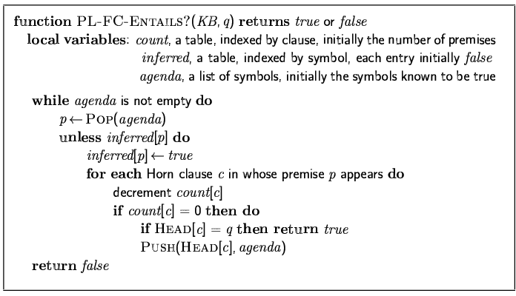
Forward Chaining Algorithm
if p = q then return true
if inferred[p] = false then
inferred[p] = true
for each clause c in KB where p is in c.Premise do
decrement count[c]
if count[c] = 0 then add c.Conclusion to agenda
Forward chaining is sound and complete for Horn KB

Slide 58
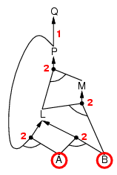
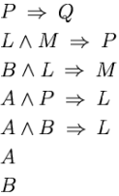
Forward Chaining Example

Slide 59
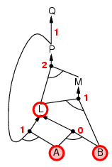
Forward Chaining Example

Slide 60
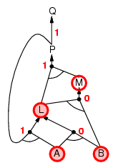
Forward Chaining Example

Slide 61
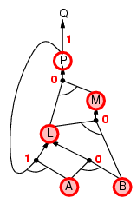
Forward Chaining Example

Slide 62
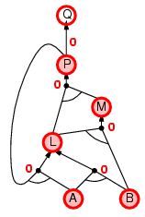
Forward Chaining Example

Slide 63

Forward Chaining Example

Slide 64
Proof of Soundness
Every inference is an application of Modus Ponens

Slide 65
Proof of Completeness
FC derives every atomic sentence that is entailed by KB
FC reaches a fixed point where no new atomic sentences are derived
Consider the final state as a model m, assigning true/false to symbols; true for each symbol inferred, false otherwise
Every definite clause in the original KB is true in m
a₁ ∧ … ∧ a_{k} ⇒ b, assuming the opposite, then it contradicts
“fixed point”
Hence, every entailed atomic sentence will be derived

Slide 66
Backward Chaining
Idea: work backwards from the query q:
to prove q by BC
check if q is known already, or
prove by BC all premises of some rule concluding q
Avoid loops: check if new subgoal is already on the goal stack
Avoid repeated work: check if new subgoal
has already been proved true, or
has already failed

Slide 67
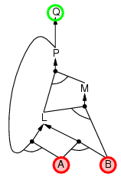
Backward Chaining Example

Slide 68
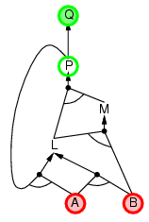
Backward Chaining Example

Slide 69
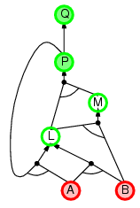
Backward Chaining Example

Slide 70
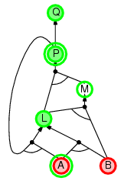
Backward Chaining Example

Slide 71
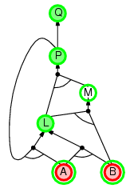
Backward Chaining Example

Slide 72
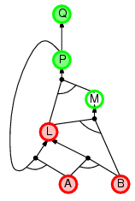
Backward Chaining Example

Slide 73
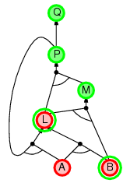
Backward Chaining Example

Slide 74
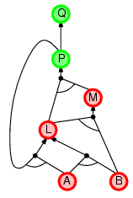
Backward Chaining Example

Slide 75
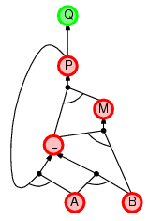
Backward Chaining Example

Slide 76
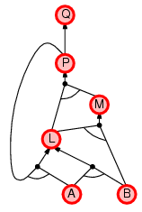
Backward Chaining Example

Slide 77
Forward vs. Backward Chaining
FC is data-driven, automatic, unconscious processing
e.g., object recognition, routine decisions
May do lots of work that is irrelevant to the goal
BC is goal-driven, appropriate for problem-solving,
e.g., Where are my keys? How do I get into a PhD program?
Complexity of BC can be much less than linear in size of KB

Slide 78
Inference-Based Agents in the Wumpus World
A wumpus-world agent using propositional logic:
¬P_{1,1}
¬W_{1,1}
B_{x,y} ⇔ (P_{x,y+1} ∨ P_{x,y-1} ∨ P_{x+1,y} ∨ P_{x-1,y})
S_{x,y} ⇔ (W_{x,y+1} ∨ W_{x,y-1} ∨ W_{x+1,y} ∨ W_{x-1,y})
W_{1,1} ∨ W_{1,2} ∨ … ∨ W_{4,4}
¬W_{1,1} ∨ ¬W_{1,2}
¬W_{1,1} ∨ ¬W_{1,3}
…
⇒ 64 distinct proposition symbols, 155 sentences

Slide 79
Expressiveness Limitation
KB contains "physics" sentences for every single square
For every time t and every location [x,y],
L_{x,y} ∧ FacingRight ^{t} ∧ Forward ^{t} ⇒ L_{x+1,y}
Rapid proliferation of clauses

Slide 80
Summary
Logical agents apply inference to a knowledge base to derive new information and make decisions
Basic concepts of logic:
syntax: formal structure of sentences
semantics: truth of sentences based on models
entailment: necessary truth of one sentence given another
inference: deriving sentences from other sentences
soundness: derivations produce only entailed sentences
completeness: derivations can produce all entailed sentences
Wumpus world requires the ability to represent partial and negated information, reason by cases, etc.
Resolution is complete for propositional logic Forward, backward chaining are linear-time, complete for Horn clauses
Propositional logic lacks expressive power

